Slide 1
2020年沈阳职业院校技能大赛职业英语（服务类）样题

Slide 2
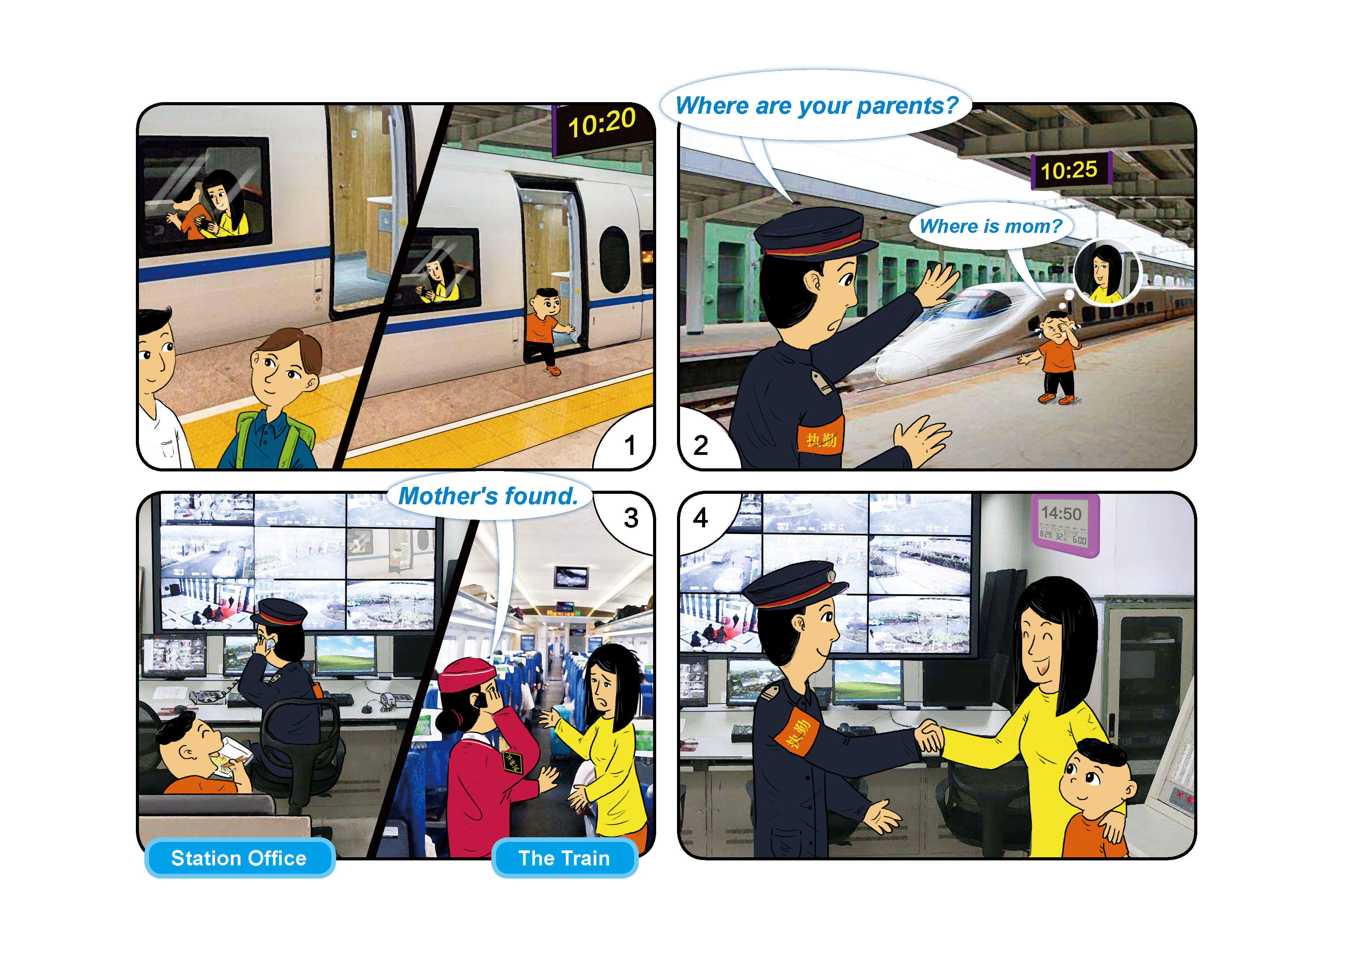
情境交流 服务类1

Slide 3
职场应用 服务类1
中职组职业英语技能赛项选拔赛（服务类专业组）
职场应用环节 赛题 1
比赛说明：
本环节包含两个阶段。
第一阶段：在备赛区进行，限时 30 分钟。两名选手通过沟通，协作完成并提交任务单
（Worksheet），按照比赛要求分别准备第二阶段的比赛内容。
第二阶段：在赛场进行，选手 A 按要求向评委陈述任务完成情况（限时 3 分钟），选手 B 回答评委的现场提问
（限时 2 分钟）。
每位选手比赛时间剩余 15 秒时，响提示铃。每位选手比赛时间终止时，响终止铃，选手必须停止汇报或作答。
比赛规则：
1. 备赛期间，两位选手只能用英语进行口头交流，不得互相展示或交换任何材料，否则将取消参赛资格。
2. 备赛期间，选手可根据需要在各自赛题上书写内容。选手离开备赛室时，只能携带赛题（含 Worksheet）， 不得携
带除赛题以外的其他资料。选手可携带各自赛题进入赛场，供汇报或回答问题时参考。
3. 备赛结束后，选手在工作人员带领下进入赛场。在此期间，两位选手不得进行任何交流，不得互相展示或交换各自
手中的材料，不得与他人进行交流，否则取消参赛资格。
4. 比赛期间，选手只能使用英语汇报或回答评委提问。
5. 比赛结束时，选手需上交全部资料

Slide 4
For Contestant A Only
选手 A：你是一家主题公园（amusement park）设施采购部门的负责人，按计划为公园
采购一批自行车供游客租用。你的队友是一名自行车经销商（bike dealer），他（她）手
头有三种自行车的信息。你需要与队友沟通，选择最合适的自行车。
在任务第一阶段（30 分钟内），你需要完成：
1. 阅读公园对自行车的要求，提取相关信息；
2. 向队友询问三种自行车的信息，根据要求完成任务单；
3. 与队友讨论，选出符合要求的自行车；
4. 准备第二阶段的汇报内容。
备注：任务单仅由选手 A 填写。
在任务第二阶段（3 分钟内），你需要向评委汇报任务完成情况。

Slide 5
For Contestant A Only
Please read the requirements of the bikes.
You are the head of the equipment purchase department of an amusement park. The park will
celebrate its third anniversary in one month and decides to start a new bike rental service for the
celebration. According to a market research, double-seat bikes are the most popular among tourists,
so the park plans to buy 100 bikes of this kind at first. The total budget is 80,000 yuan. The tourists
visiting the park are of different ages and over 70% of them are parents with their kids. It is important
that the height of bike seats can be adjusted easily to fit the height of riders. What is more, the color
of the bikes should go with the main color of the park, which is pink, and it would be the best if the
park’s logo can be painted on them.

Slide 6
Worksheet
Section 1 Communicate with Contestant B and complete the following form
Bike model | Adjustable seat (Yes/No) | Color in stock | Total cost | Time needed to get the bikes you need
Model A
Model B
Model C
Section2 Discuss with Contestant B and choose the suitable model of bikes.
Your choice is __________________

Slide 7
中职组职业英语技能赛项选拔赛（服务类专业组）
职场应用环节 赛题 1
比赛说明：
本环节包含两个阶段。
第一阶段：在备赛区进行，限时 30 分钟。两名选手通过沟通，协作完成并提交任务单
（Worksheet），按照比赛要求分别准备第二阶段的比赛内容。
第二阶段：在赛场进行，选手 A 按要求向评委陈述任务完成情况（限时 3 分钟），选手 B 回答评委的现场提问（限时 2 分钟）。
每位选手比赛时间剩余 15 秒时，响提示铃。每位选手比赛时间终止时，响终止铃，选手必须停止汇报或作答。
比赛规则：
备赛期间，两位选手只能用英语进行口头交流，不得互相展示或交换任何材料，否则将取消参赛资格。
备赛期间，选手可根据需要在各自赛题上书写内容。选手离开备赛室时，只能携带赛题
（含 Worksheet），不得携带除赛题以外的其他资料。选手可携带各自赛题进入赛场，供汇报或回答问题时参考。
备赛结束后，选手在工作人员带领下进入赛场。在此期间，两位选手不得进行任何交流，不得互相展示或交换各自手中的
材料，不得与他人进行交流，否则取消参赛资格。
比赛期间，选手只能使用英语汇报或回答评委提问。
比赛结束时，选手需上交全部资料。

Slide 8
For Contestant B Only
选手 B：你是一名自行车经销商（bike dealer），手头有三种自行车的信息。你的队友是一家
主题公园（amusement park）设施采购部门的负责人，需要为公园采购一批自行车
供游客租用。你需要与队友沟通，帮助他（她）选择最合适的自行车。
在任务第一阶段（30 分钟内），你需要完成：
1. 阅读三种自行车的资料，提取相关信息；
2. 与队友沟通，向其提供所需信息，协助队友完成任务单；
3. 与队友讨论，选出符合要求的自行车；
4. 准备第二阶段的问答内容。
备注：任务单仅由选手 A 填写。
在任务第二阶段（2 分钟内），你需要回答评委现场提出的 3 个问题。回答须与实际任务相
结合，观点鲜明，有理有据，有逻辑性。

Slide 9
For Contestant B Only
Please read the information on the three models of bikes and help Contestant A complete the worksheet.
Model A
This model of double-seat bikes is new to the market. It features a beautiful new design, and has an extra small seat for carrying little
kids. Riders can adjust the height of the seats easily using the handle under each seat. Currently, the model has black, red, and light pink
color in stock, and can be delivered within 10 days after placing the order. Other colors, such as green and white, will need one
month’s wait before delivery.
The price for each bike is 800 yuan. Orders of 100 units or more can enjoy a discount of 50 yuan per unit and free delivery.
Model B
This is the bestselling double-seat bike model of the year. The design of its seats can help to reduce the riders’ discomfort after
long-time riding. Riders can also change the height of the seats to their preferences. Due to the popularity of the model, it only has
the black color in stock for now. However, the good news is that the manufacturer provides a customization service. It means that you can
choose any color you like and have your own logo or pattern painted on the bike. The production time of customized bikes is only
30 days, and it will take an extra one week for the bike to be sent to your address. The price of the bike is 800 yuan per unit including
the delivery fee.
Model C
This is one of the most popular double-seat bike models this year. With a unibody structure (一体式结构) and fixed-height seats,
the design of the bike aims at providing a high level of durability. This makes it a perfect choice for public bikes. The model has been
on sale recently. It is now priced at only 650 yuan per unit with delivery cost included! There are many colors available immediately,
such as red, pink, yellow, and black. You can get them within a week after placing your order.

Slide 10
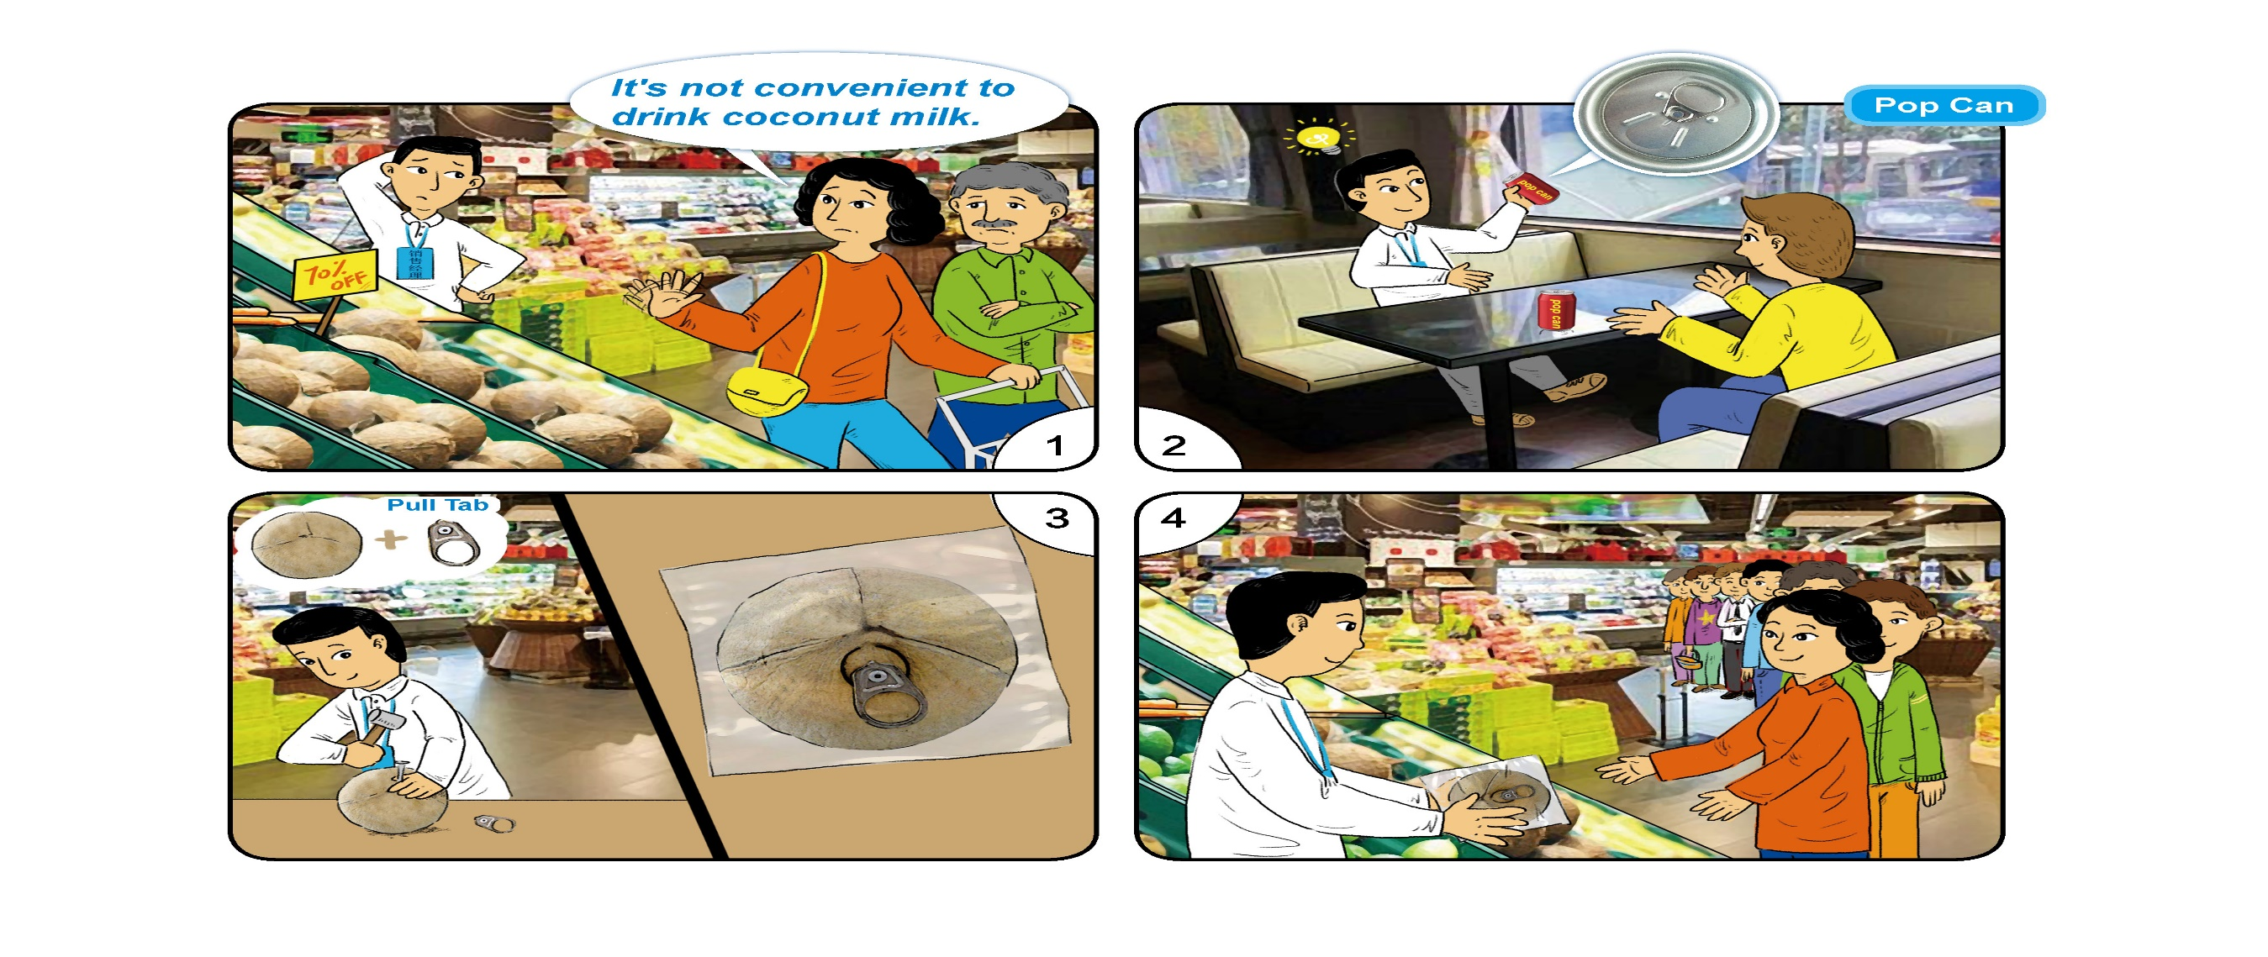
服务类2

Slide 11
职场应用环节 赛题 2
比赛说明：
本环节包含两个阶段。
第一阶段：在备赛区进行，限时 30 分钟。两名选手通过沟通，协作完成并提交任务单（Worksheet），按照比赛要求分别准备第二阶段的比赛内容。
第二阶段：在赛场进行，选手 A 按要求向评委陈述任务完成情况（限时 3 分钟），选手 B 回答评委的现场提问（限时 2 分钟）。每位选手比赛时间剩余 15 秒时，
响提示铃。每位选手比赛时间终止时，响终止铃，选手必须停止汇报或作答。
比赛规则：
1. 备赛期间，两位选手只能用英语进行口头交流，不得互相展示或交换任何材料，否则将取消参赛资格。
2. 备赛期间，选手可根据需要在各自赛题上书写内容。选手离开备赛室时，只能携带赛题（含 Worksheet），不得携带除赛题以外的其他资料。选手可携带
各自赛题进入赛场，供汇报或回答问题时参考。
3. 备赛结束后，选手在工作人员带领下进入赛场。在此期间，两位选手不得进行任何交流，不得互相展示或交换各自手中的材料，
不得与他人进行交流，否则取消参赛资格。
4. 比赛期间，选手只能使用英语汇报或回答评委提问。
5. 比赛结束时，选手需上交全部资料。

Slide 12
For Contestant A Only
选手 A：你是一家化工厂（chemical factory）的人力资源部门主管，将于近期组织工人进行
年度体检。你的队友是人力资源部门的员工，通过市场调查，他（她）掌握了三家
体检机构（health checkup clinic）的信息。你需要与队友沟通，选择最合适的体检
机构。
在任务第一阶段（30 分钟内），你需要完成：
1. 阅读员工体检要求，提取相关信息；
2. 向队友询问三家体检机构的信息，根据要求完成任务单；
3. 与队友讨论，选出符合要求的体检机构；
4. 准备第二阶段的汇报内容。
备注：任务单仅由选手 A 填写。
在任务第二阶段（3 分钟内），你需要向评委汇报任务完成情况

Slide 13
For Contestant A Only
Please read the requirements of the health checkup.
You are the head of the human resource department of a chemical factory. The factory is planning a
yearly health checkup for its 210 workers. The budget for each worker’s checkup is 900 yuan, and
the checkup needs to cover at least 15 out of the 20 basic tests—the more the better. Because the
workers are working with poisonous chemicals, a special lung function test is also necessary. The
production line of the factory runs 24 hours every day, so the workers having the checkup in the
morning must return to the factory to take the afternoon shift. A bus will be arranged to take them
back, but it should not take more than 50 minutes on the road so that they can have enough time for
lunch.

Slide 14
Worksheet
Section 1 Communicate with Contestant B and complete the following form.
Checckup clinic | Number of basic tests | Lung function test (Yes/No) | Cost per worker | Distance from the factory
Clinic A
Clinic B
Clinic C
Section 2 Discuss with Contestant B and choose the suitable checkup clinic.
Your choice is _____________________________

Slide 15
职场应用环节 赛题 2
比赛说明：
本环节包含两个阶段。
第一阶段：在备赛区进行，限时 30 分钟。两名选手通过沟通，协作完成并提交任务单（Worksheet），按照比赛要求
分别准备第二阶段的比赛内容。
第二阶段：在赛场进行，选手 A 按要求向评委陈述任务完成情况（限时 3 分钟），选手 B 回答评委的现场提问（限时
2 分钟）。每位选手比赛时间剩余 15 秒时，响提示铃。每位选手比赛时间终止时，响终止铃，选手必须
停止汇报或作答。
比赛规则：
备赛期间，两位选手只能用英语进行口头交流，不得互相展示或交换任何材料，否则将取消参赛资格。
备赛期间，选手可根据需要在各自赛题上书写内容。选手离开备赛室时，只能携带赛题（含 Worksheet），不得携带
除赛题以外的其他资料。选手可携带各自赛题进入赛场，供汇报或回答问题时参考。
不得互相展示或交换各自手中的材料，不得与他人进行交流，否则取消参赛资格。
比赛期间，选手只能使用英语汇报或回答评委提问。
比赛结束时，选手需上交全部资料。

Slide 16
For Contestant B Only
选手 B：你是一家化工厂（chemical factory）人力资源部门的员工，通过市场调查，你掌握
了三家体检机构（health checkup clinic）的信息。你的队友是人力资源部门的主管，
需要从三家机构中选择一家为本厂员工进行年度体检。你需要与队友沟通，帮助他
（她）选择最合适的体检机构。
在任务第一阶段（30 分钟内），你需要完成：
1. 阅读三家体检机构的资料，提取相关信息；
2. 与队友沟通，向其提供所需信息，协助队友完成任务单；
3. 与队友讨论，选出符合要求的体检机构；
4. 准备第二阶段的问答内容。
备注：任务单仅由选手 A 填写。
在任务第二阶段（2 分钟内），你需要回答评委现场提出的 3 个问题。回答须与实际任务相
结合，观点鲜明，有理有据，有逻辑性

Slide 17
For Contestant B Only
Please read the information on the three health checkup clinics and help Contestant A complete the worksheet.
Clinic A
This checkup clinic belongs to the biggest hospital of the city. The experienced doctors and nurses from the hospital ensure the high level of its tests. Although
the clinic only offers standard checkup,
which includes 17 out of the 20 basic tests, the price is very attractive: 750 yuan per person. It is the best deal of the city! The location of the checkup clinic is
very convenient. It is less than 2 kilometers away from the factory. We can even save the money for arranging the return buses.
Clinic B
This checkup clinic belongs to a nation-wide checkup service chain. It is its first clinic in this city. Its standard checkup includes 15 out of the 20 basic tests with a price
of 900 yuan per person. As
the clinic is newly opened, it has a special discount for group checkups. For groups more than 200 people, the discounted price is 750 yuan each. You can also add
other tests to the standard checkup.
The price for an extra lung function test is 100 yuan per person. The clinic offers express health report service for free. You can get the checkup results within three
days. It is about 40 minutes’ drive from the clinic to the factory.
Clinic C
This checkup clinic has a great reputation for providing warm and reliable services. It has a team of experienced professionals and first-class equipment.
Its standard checkup covers 20 out of the 20 basic tests and is priced at only 850 yuan per person. You can also customize the checkup by adding
the tests you need. An extra lung function test costs only 60 yuan per person. The clinic provides a unique cell phone service. By using the clinic’s smart
phone application, you can conveniently view your checkup report anywhere anytime. The distance from the clinic to the factory is a bit far—
about 45 minutes’ bus ride.

